Slide 1
Data Link Layer

Slide 2
Error detection and correction
The link-layer hardware in a receiving node can incorrectly decide that a bit in a frame is zero when it was transmitted as a one, and vice versa.
Bit errors are introduced by signal attenuation and electromagnetic noise.
Because there is no need to forward a datagram that has an error, many link-layer protocols provide a mechanism to detect such bit errors.
This is done by having the transmitting node include error-detection bits in the frame, and having the receiving node perform an error check.
Error detection in the link layer is usually more sophisticated and is implemented in hardware.

Slide 3

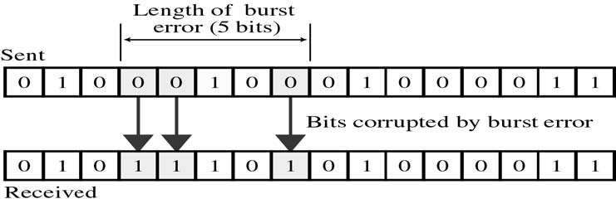
Types of Errors
There are two main types of errors in transmissions:
1. Single bit error : It means only one bit of data unit is changed from 1 to 0 or from 0 to 1.
2. Burst error : It means two or more bits in data unit are changed from 1 to 0 from 0 to 1. In burst error, it is not necessary that only consecutive bits are changed. The length of burst error is measured from first changed bit to last changed bit
22

Slide 4
ERROR CORRECTION AND DETECTION
Error correction is similar to error detection, except that a receiver not only detects when bit errors have occurred in the frame but also determines exactly where in the frame the errors have occurred (and then corrects these errors).
Thus, error detection and correction is critical to accurate data transmission, storage and retrieval.
Detecting and correcting errors requires redundancy - sending additional information along with the data.
21

Slide 5
Redundancy & Coding
To be able to detect or correct errors, we need to send some extra bits with our data.
These redundant bits are added by the sender and removed by the receiver.
Their presence allows the receiver to detect or correct corrupted bits.
Redundancy is achieved through various coding schemes.
The sender adds redundant bits through a process that creates a relationship between the redundant bits and the actual data bits.
The receiver checks the relationships between the two sets of bits to detect or correct the errors.
The ratio of redundant bits to the data bits and the robustness of the process are important factors in any coding scheme.
Notes:
Robustness - the quality or condition of being strong and in good condition.

Slide 6
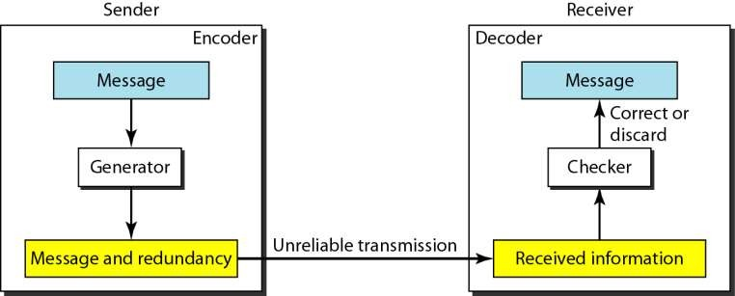
The structure of Encoder and Decoder
23

Slide 7
VERTICAL REDUNDANCY CHECK (VRC)
Append a single bit at the end of data block such that the number of ones is even
Even Parity (odd parity is similar)
0110011 → 01100110
0110001 → 01100011
VRC is also known as Parity Check.
Detects all odd-number errors in a data block

Slide 8
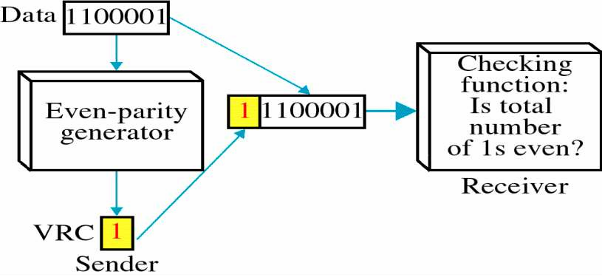
VERTICAL REDUNDANCY CHECK (VRC)

Slide 9
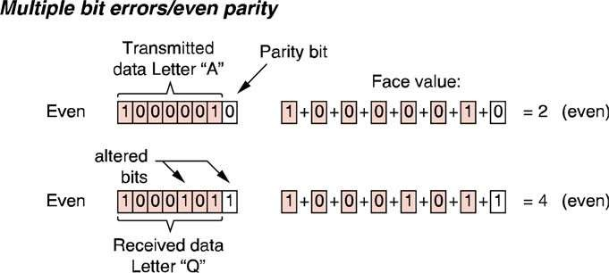
EXAMPLE OF VRC
The problem with parity is that it can only detect odd numbers of bit substitution errors, i.e. 1 bit, 3bit, 5, bit, etc. errors.
If there two, four, six, etc. bits which are transmitted in error, using VRC will not be able to detect the error.
26

Slide 10

CHECKSUM
Checksum is the error detection scheme used in IP, TCP & UDP.
Here, the data is divided into k segments each of m bits. In the sender’s end the segments are added using 1’s complement arithmetic to get the sum. The sum is complemented to get the checksum. The checksum segment is sent along with the data segments
At the receiver’s end, all received segments are added using 1’s complement arithmetic to get the sum. The sum is complemented. If the result is zero, the received data is accepted; otherwise discarded
The checksum detects all errors involving an odd number of bits. It also detects most errors involving even number of bits.
43

Slide 11
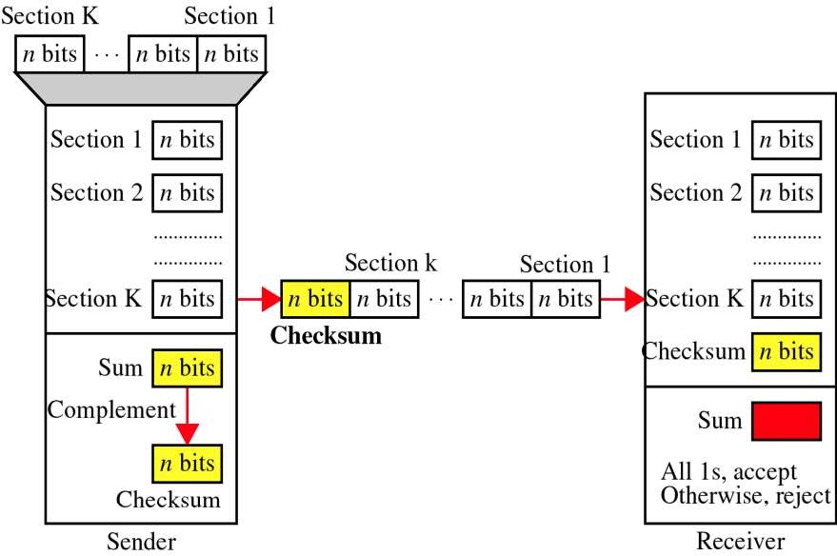
CHECKSUM
CHECKSUM
44

Slide 12
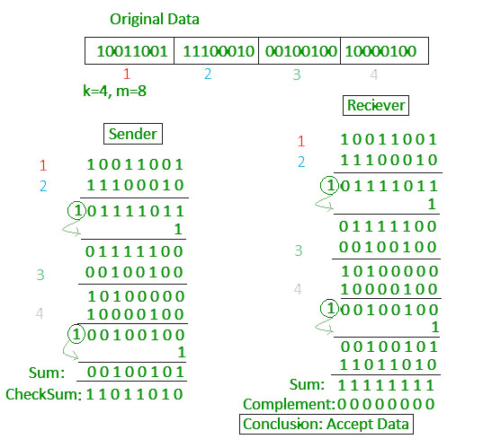
Example

Slide 13
Example
Check sum:
Original Data :
10011001
11100010
00100100
10000100
Checksum: 11011010

Slide 14
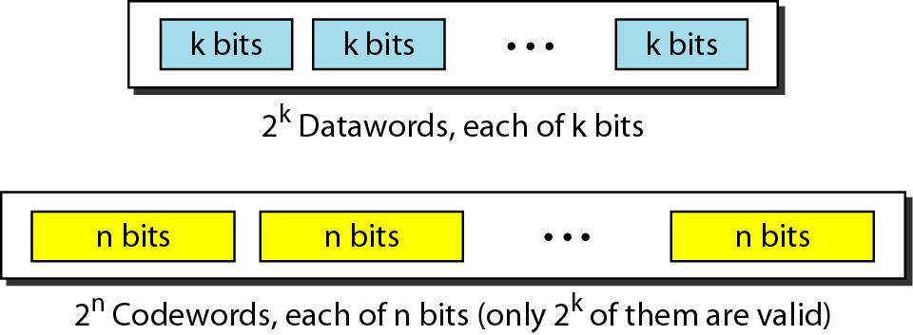
BLOCK CODING
In block coding,
the message is divided into blocks, each of k bits, called data words.
r redundant bits are added to each block to make the length n = k + r, resulting in n-bit blocks called codewords.

Slide 15
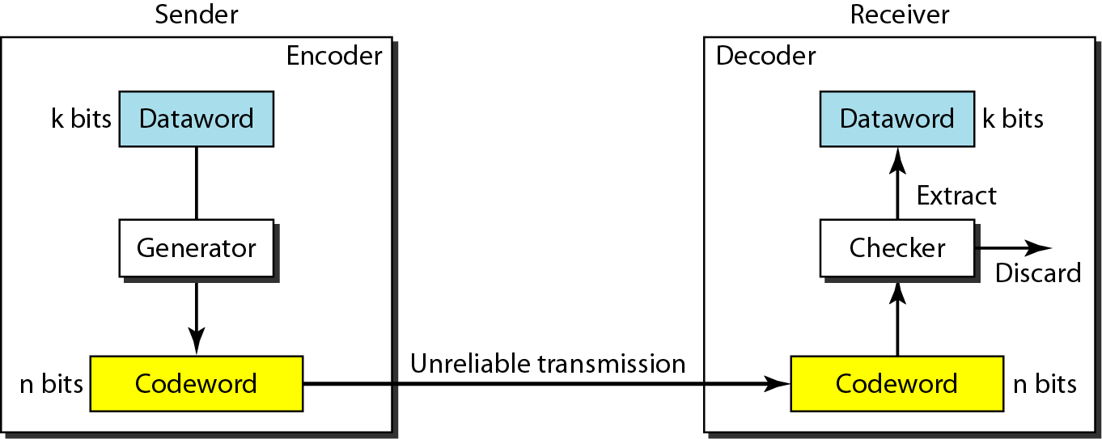
Process of error detection in block coding

Slide 16
Cyclic Redundancy Check (CRC) Codes
An error-detection technique used widely in today’s computer networks is based on cyclic redundancy check (CRC) codes.
CRC codes are also known as polynomial codes, since it is possible to view the bit string to be sent as a polynomial whose coefficients are the 0 and 1 values in the bit string, with operations on the bit string interpreted as polynomial arithmetic.
The theoretical foundation of the cyclic redundancy check is rooted in a branch of mathematics called finite fields.

Slide 17
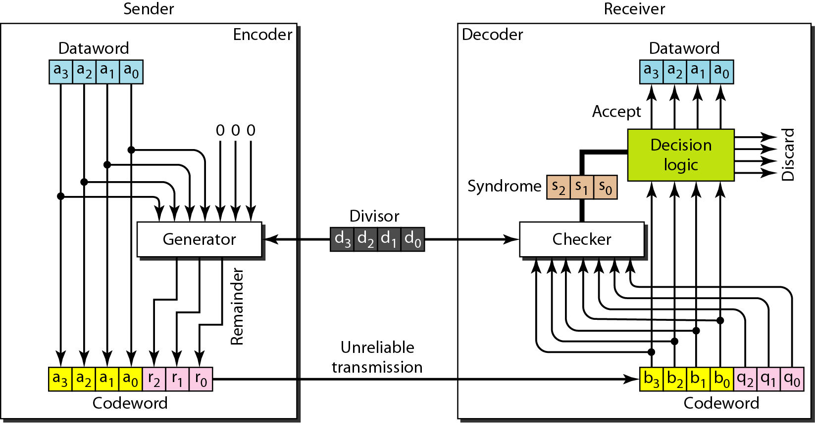
CRC encoder and decoder

Slide 18
Cyclic Redundancy Check (CRC)
Encoder
the dataword has k bits (4 here);
the codeword has n bits (7 here).
The size of the dataword is augmented by adding n - k (3 here) 0s to the right-hand side of the word.
The n-bit result is fed into the generator.
The generator uses a divisor of size n - k + 1 (4 here), predefined and agreed upon.
The generator divides the augmented dataword by the divisor (modulo-2 division).
The quotient of the division is discarded;
the remainder is appended to the dataword to create the codeword.

Slide 19
Cyclic Redundancy Check (CRC)
Decoder
The decoder receives the possibly corrupted codeword.
A copy of all n bits is fed to the checker which is a replica of the generator.
The remainder produced by the checker is a syndrome of n - k (3 here) bits, which is fed to the decision logic analyzer.
The analyzer has a simple function.
If the syndrome bits are all 0s, the 4 leftmost bits of the codeword are accepted as the dataword (interpreted as no error); otherwise, the 4 bits are discarded (error).

Slide 20
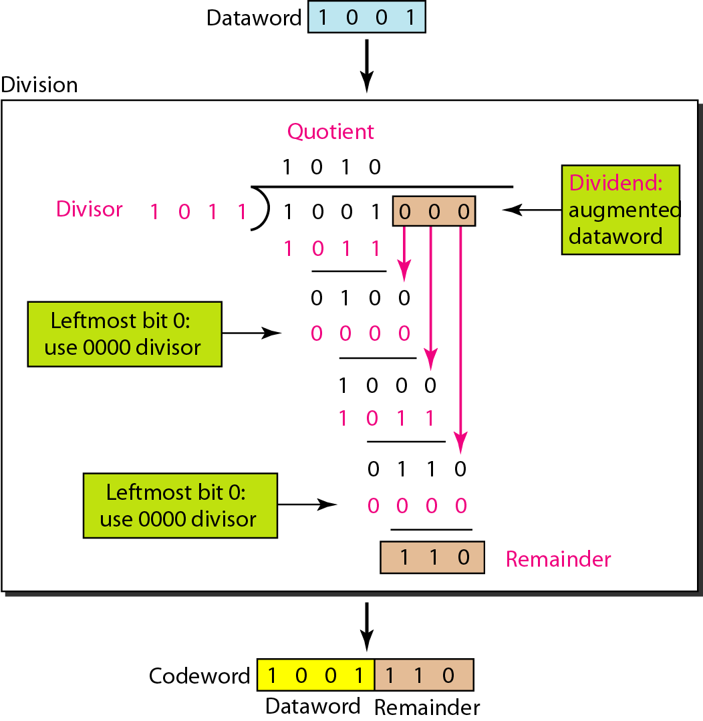
Division in CRC encoder
The encoder takes the data word and augments it with n - k numbers.
It then divides the augmented dataword by the divisor.

Slide 21
Division in the CRC decoder
The codeword can change during transmission.
The decoder does the same division process as the encoder.
The remainder of the division is the syndrome.
If the syndrome is all 0s, there is no error; the dataword is separated from the received codeword and accepted.
Otherwise, everything is discarded.

Slide 22
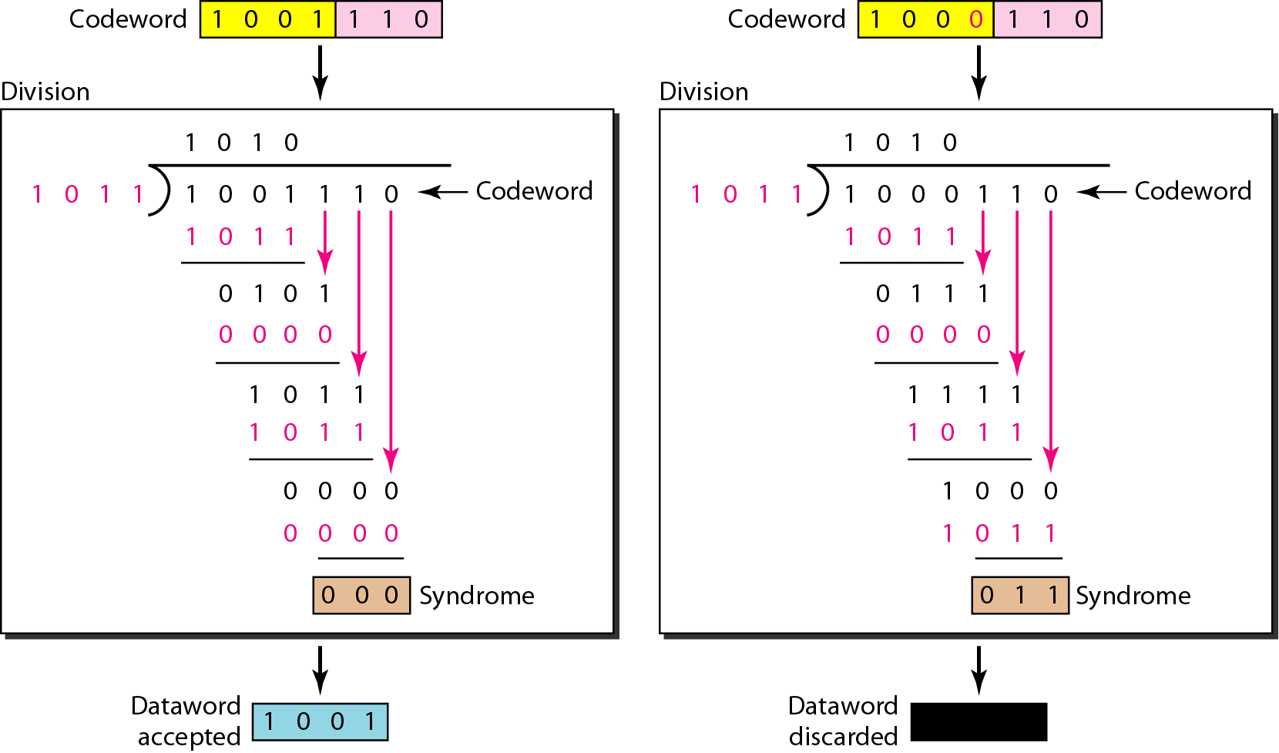
Division in the CRC decoder for two cases

Slide 23
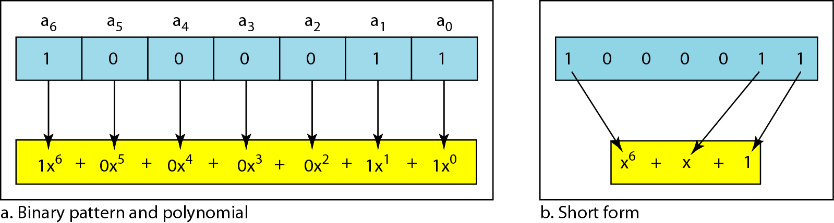
Polynomial representation of a binary word
A pattern of 0s and 1s can be represented as a polynomial with coefficients of 0 and 1.
The power of each term shows the position of the bit; the coefficient shows the value of the bit.

Slide 24
Polynomial Arithmetic for CRC
All CRC calculations are done in modulo-2 arithmetic without carries in addition or borrows in subtraction.
This means that addition and subtraction are identical, and both are equivalent to the bitwise exclusive-or (XOR) of the operands.

Slide 25
GENERATOR POLYNOMIAL
A cyclic redundancy check (CRC) is a non-secure hash function designed to detect accidental changes to raw computer data, and is commonly used in digital networks and storage devices such as hard disk devices.
CRCs are so called because the check (data verification) code is
a redundancy (it adds zero information) and the algorithm is based on cyclic codes.
The term CRC may refer to the check code or to the function that calculates it, which accepts data streams of any length as input but always outputs a fixed- length code
The divisor in a cyclic code is normally called the generator polynomial or simply the generator. The proper
1. It should have at least two terms.
2. The coefficient of the term x⁰ should be 1.
32

Slide 26
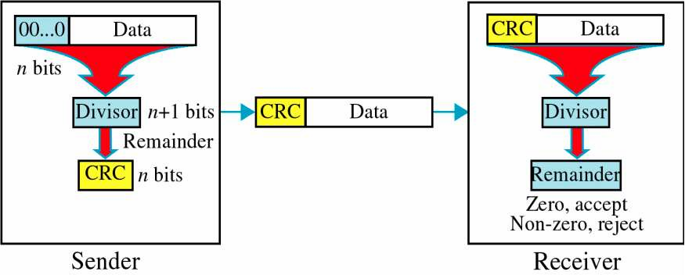
CRC CALCULATION
Given a k-bit frame or message, the transmitter generates an n-bit sequence, known as a frame check sequence (FCS), so that the resulting frame, consisting of (k+n) bits, is exactly divisible by some predetermined number.
33

Slide 27
CYCLIC REDUNDANCY CHECK
Let M(x) be the message polynomial
Let P(x) be the generator polynomial
P(x) is fixed for a given CRC scheme
P(x) is known both by sender and receiver
Create a block polynomial F(x) based on M(x) and P(x) such that F(x) is divisible by P(x)

Slide 28
CYCLIC REDUNDANCY CHECK
Sending
Multiply M(x) by x^{n}
Divide x^{n}M(x) by P(x)
Ignore the quotient and keep the reminder C(x)
Form and send F(x) = x^{n}M(x)+C(x)
Receiving
Receive F’(x)
Divide F’(x) by P(x)
Accept if remainder is 0, reject otherwise

Slide 29
EXAMPLE OF CRC
Consider a message 110010 represented by the polynomial M(x) = x⁵ + x⁴ + x Consider a generating polynomial P(x) = x³ + x² + 1 (1101)
This is used to generate a 3 bit CRC = C(x) to be appended to M(x).
Steps:
Multiply M(x) by x³ (highest power in P(x)). i.e. Add 3 zeros. 110010000
Divide the result by P(x). The remainder = C(x).
1101 long division into 110010000 (with subtraction mod 2)
= 100100 remainder
3. Transmit 110010000 + 100100
To be precise, transmit: T(x) = x³M(x) + C(x) = 110010100
4. Receiver end: Receive T(x). Divide by P(x), should have remainder 0.
Note if P(x) has order n - highest power is x^{n}, then P(x) will cover (n+1) bits and the remainder will cover n bits. i.e. Add n bits to message.
36

Slide 30
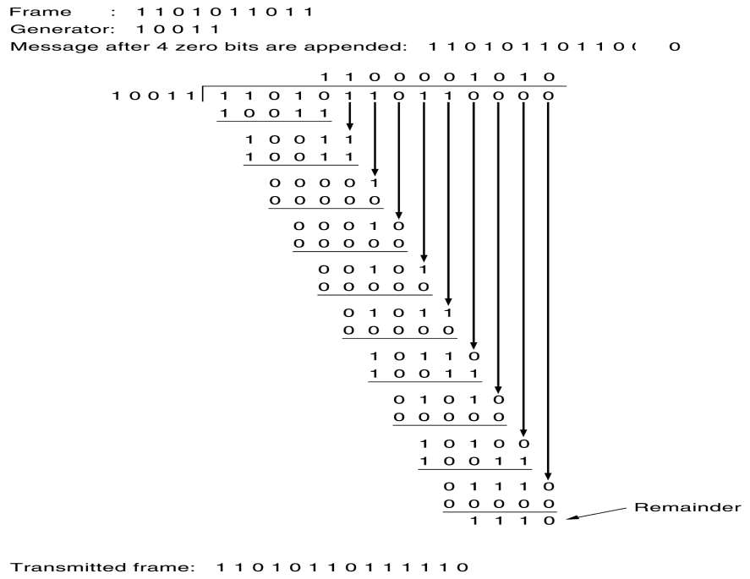
37

Slide 31

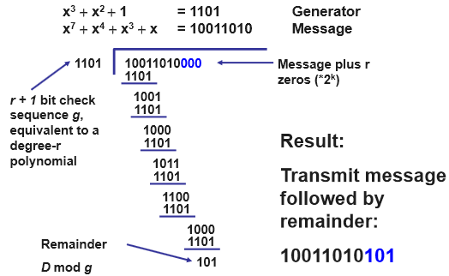





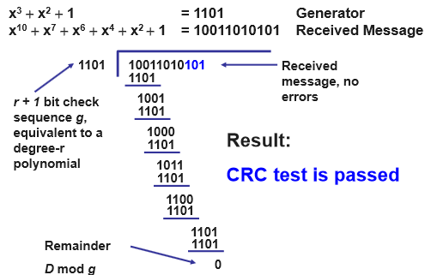


38

Slide 32




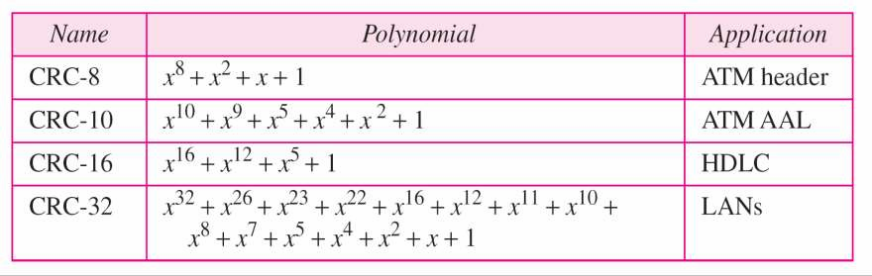


CRC STANDARD POLYNOMIALS
CRC PERFORMANCE
CRC is a very effective error detection technique. If the divisor is chosen according to the previously mentioned rules, its performance can be summarized as follows:
CRC can detect all single-bit errors
CRC can detect all double-bit errors (three 1’s)
CRC can detect any odd number of errors (X+1)
CRC can detect all burst errors of less than the degree of the polynomial.
CRC detects most of the larger burst errors with a high probability.
For example CRC-12 detects 99.97% of errors with a length 12 or more.
42

Slide 33
Reliable Transmission /Flow Control
Reliability is a function that may be provided at the link level
CRC is used to detect errors.
Some error codes are strong enough to correct errors.
The overhead is typically too high.
Corrupt frames must be discarded.
A link-level protocol that wants to deliver frames reliably must recover from these discarded frames.
This is accomplished using a combination of two fundamental mechanisms
Acknowledgements and Timeouts

Slide 34
Reliable Transmission
An acknowledgement (ACK for short) is a small control frame that a protocol sends back to its peer saying that it has received the earlier frame.
A control frame is a frame with header only (no data).
The receipt of an acknowledgement indicates to the sender of the original frame that its frame was successfully delivered.

Slide 35
Reliable Transmission
If the sender does not receive an acknowledgment after a reasonable amount of time, then it retransmits the original frame.
The action of waiting a reasonable amount of time is called a timeout.
The general strategy of using acknowledgements and timeouts to implement reliable delivery is sometimes called Automatic Repeat reQuest (ARQ).

Slide 36
Acknowledgment
Negative Acknowledgment (NACK): the receiver explicitly notifies the sender which packets were received incorrectly and thus may need to be retransmitted
Selective Acknowledgment (SACK): the receiver explicitly lists which packets in a stream are acknowledged (either negatively or positively).
Cumulative Acknowledgment: the receiver acknowledges that it correctly received a packets in a stream which implicitly informs the sender that the previous packets were received correctly. TCP uses cumulative acknowledgment with its TCP sliding window

Slide 37
Stop and Wait Protocol
Idea of stop-and-wait protocol is straightforward
After transmitting one frame, the sender waits for an acknowledgement before transmitting the next frame.
If the acknowledgement does not arrive after a certain period of time, the sender times out and retransmits the original frame

Slide 38
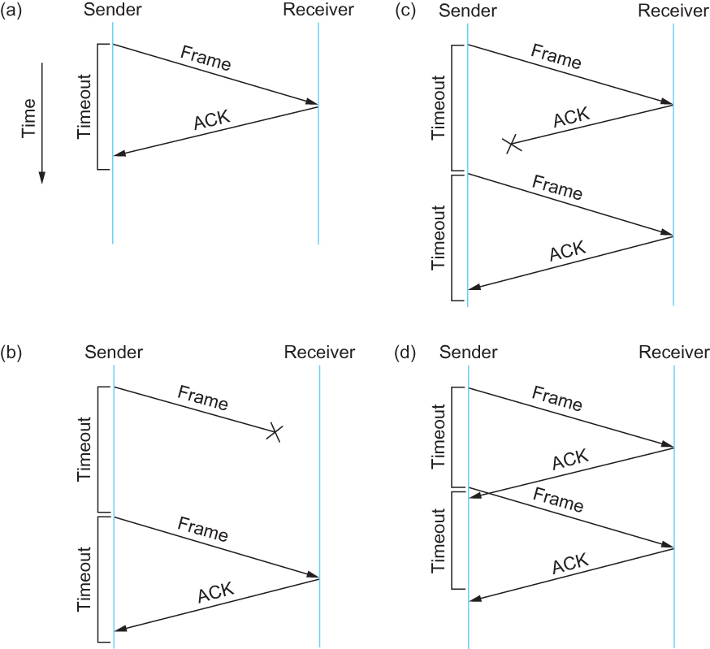
Stop and Wait Protocol
Timeline showing four different scenarios for the stop-and-wait algorithm.
(a) The ACK is received before the timer expires; (b) the original frame is lost; (c) the
ACK is lost; (d) the timeout fires too soon

Slide 39
Stop and Wait Protocol
If the acknowledgment is lost or delayed in arriving
The sender times out and retransmits the original frame, but the receiver will think that it is the next frame since it has correctly received and acknowledged the first frame
As a result, duplicate copies of frames will be delivered
How to solve this?
To address this problem, the header for a stop-and-wait protocol usually includes a 1-bit sequence number—that is, the sequence number can take on the values 0 and 1—and the sequence numbers used for each frame alternate.
When the sender retransmits frame 0, the receiver can determine that it is seeing a second copy of frame 0 rather than the first copy of frame 1 and therefore can ignore it (the receiver still acknowledges it, in case the first acknowledgement was lost)

Slide 40
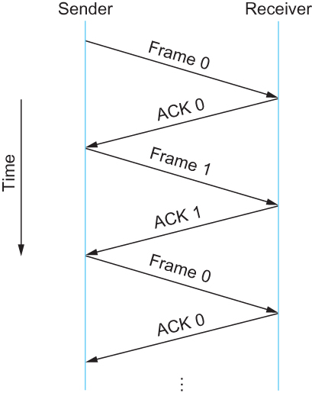
Stop and Wait Protocol
Timeline for stop-and-wait with 1-bit sequence number

Slide 41
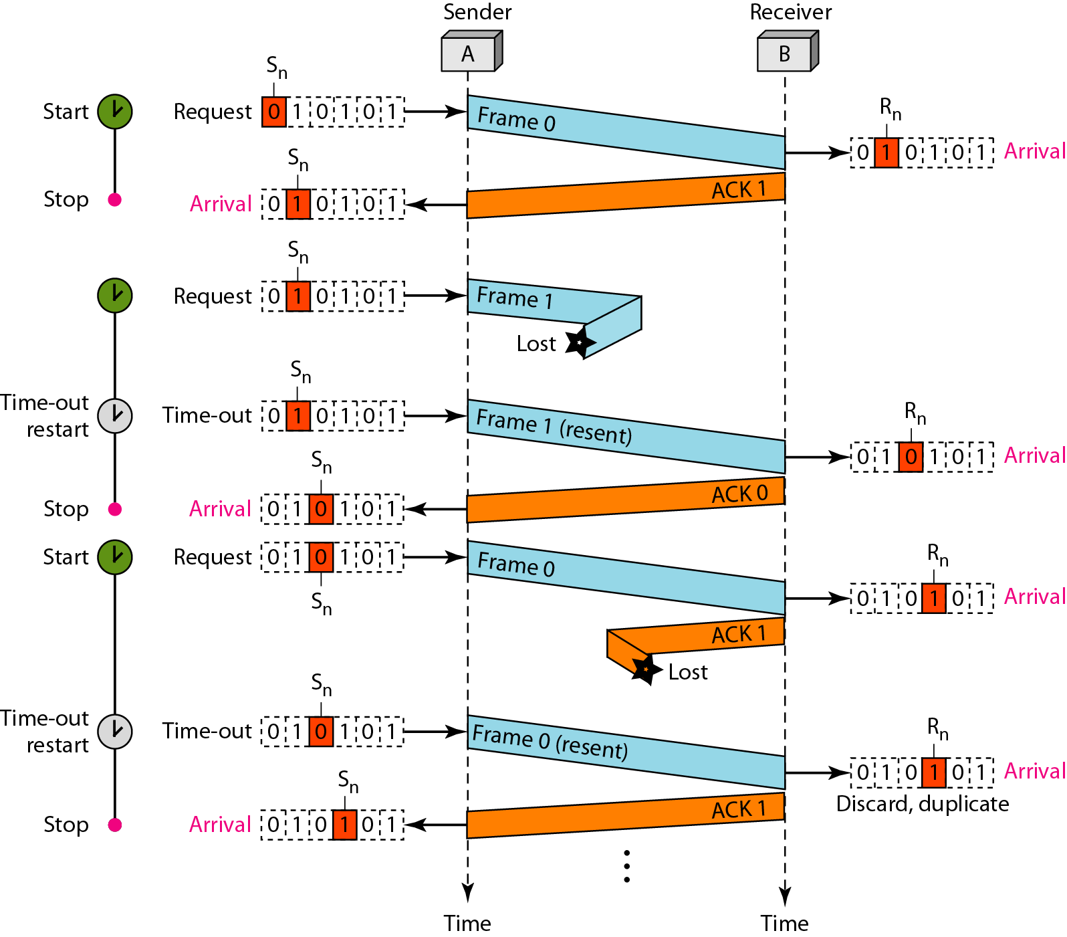
Frame 0 is sent and acknowledged.
Frame 1 is lost and resent after the time-out. The resent frame 1 is acknowledged and the timer stops.
Frame 0 is sent and acknowledged, but the acknowledgment is lost. The sender has no idea if the frame or the acknowledgment is lost, so after the time-out, it resends frame 0, which is acknowledged.
Receiver’s Acknowledgement number is what is expected next:
After receiving Frame 0, sends back ACK 1
After receiving Frame 1, sends back ACK 0
Sn - the sequence number of the next frame to be sent
Rn - that holds the number of the next frame expected.

Slide 42
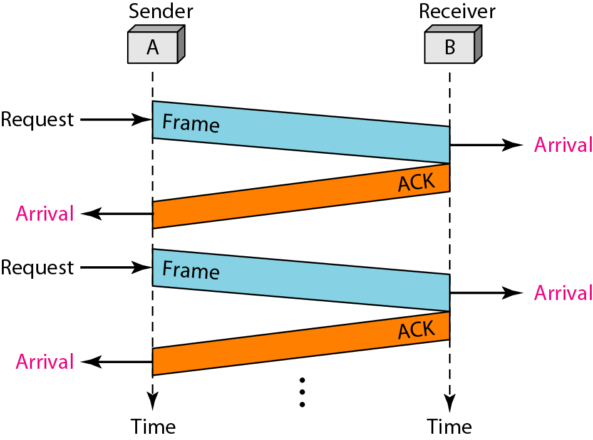
Stop-and-Wait
The main shortcoming of the stop-and-wait algorithm is that it allows the sender to have only one outstanding frame on the link at a time, and this may be far below the link’s capacity.

Slide 43
Stop and Wait Protocol
The sender has only one outstanding frame on the link at a time
This may be far below the link’s capacity
Consider a 1.5 Mbps link with a 45 ms RTT
The link has a delay × bandwidth product of 67.5 Kb or approximately
8KB
Since the sender can send only one frame per RTT and assuming a frame size of 1 KB
Maximum Sending rate
Bits per frame ÷ Time per frame = 1024 × 8 ÷ 0.045 = 182 Kbps
Or about one-eighth of the link’s capacity(1/8)
To use the link fully, then sender should transmit up to eight frames before having to wait for an acknowledgement

Slide 44
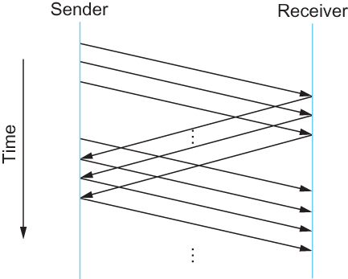
Sliding Window Protocol
sender send more than one frames to the receiver side and
re-transmit the frame which are/is damaged or suspected.
Timeline for Sliding Window Protocol

Slide 45
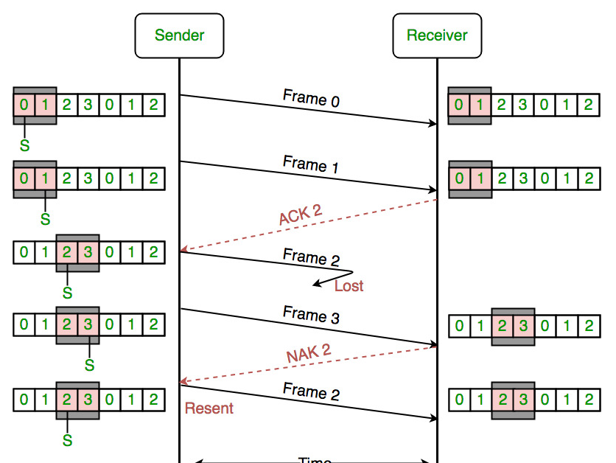
Sliding Window Protocol

Slide 46
Sliding Window Protocol
Sender assigns a sequence number denoted as SeqNum to each frame.
Assume it can grow infinitely large
Sender maintains three variables
Send Window Size (SWS)
Upper bound on the number of outstanding (unacknowledged) frames that the sender can transmit
Last Acknowledgement Received (LAR)
Sequence number of the last acknowledgement received
Last Frame Sent (LFS)
Sequence number of the last frame sent

Slide 47
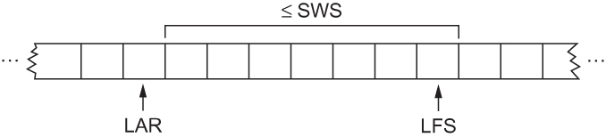
Sliding Window Protocol
Sender also maintains the following invariant
LFS – LAR ≤ SWS
Sliding Window on Sender

Slide 48
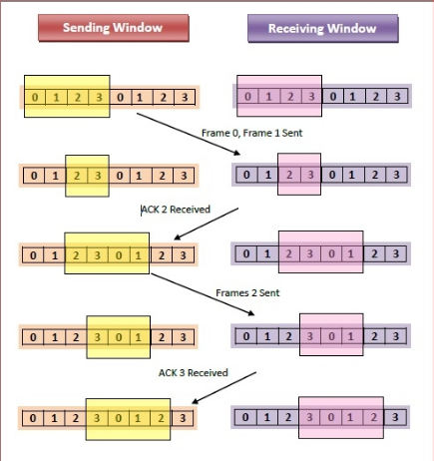
Sliding Window Protocol

Slide 49
Sliding Window Protocol
When an acknowledgement arrives
the sender moves LAR to right, thereby allowing the sender to transmit another frame
Also the sender associates a timer with each frame it transmits
It retransmits the frame if the timer expires before the ACK is received
Note that the sender has to be willing to buffer up to SWS frames
WHY?
The sender has to be willing to buffer up to SWS frames since it must be prepared to retransmit them until they are acknowledged.

Slide 50
Sliding Window Protocol
Receiver maintains three variables
Receiving Window Size (RWS)
Upper bound on the number of out-of-order frames that the receiver is willing to accept
Largest Acceptable Frame (LAF)
Sequence number of the largest acceptable frame
Last Frame Received (LFR)
Sequence number of the last frame received

Slide 51
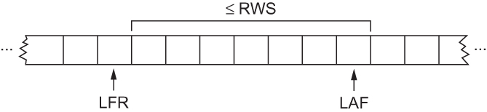
Sliding Window Protocol
Receiver also maintains the following invariant
LAF – LFR ≤ RWS
Sliding Window on Receiver

Slide 52
Sliding Window Protocol
When a frame with sequence number SeqNum arrives, what does the receiver do?
If SeqNum ≤ LFR or SeqNum > LAF
Discard it (the frame is outside the receiver window)
If LFR < SeqNum ≤ LAF
Accept it
Now the receiver needs to decide whether or not to send an ACK

Slide 53
Sliding Window Protocol
Let SeqNumToAck
Denote the largest sequence number not yet acknowledged, such that all frames with sequence number less than or equal to SeqNumToAck have been received.
The receiver acknowledges the receipt of SeqNumToAck even if high-numbered packets have been received
This acknowledgement is said to be cumulative.
The receiver then sets
LFR = SeqNumToAck and adjusts
LAF = LFR + RWS

Slide 54
Sliding Window Protocol
For example, suppose LFR = 5 and RWS = 4
(i.e. the last ACK that the receiver sent was for seq. no. 5)
LAF = 9
If frames 7 and 8 arrive, they will be buffered because they are within the receiver window, But no ACK will be sent since frame 6 is yet to arrive
Frames 7 and 8 are out of order Frame 6 arrives (it is late because it was lost first time and had to be retransmitted)
Now Receiver Acknowledges Frame 8 and bumps LFR to 8
and LAF to 12

Slide 55
Handling frame loss
The receiver could have sent a negative acknowledgment (NAK) for frame 6 as soon as frame 7 arrived.
It would have been legitimate to send additional acknowledgments of frame 5 when frames 7 and 8 arrived;
in some cases, a sender can use duplicate ACKs as a clue that a frame was lost.
Both approaches help to improve performance by allowing early detection of packet losses.
Yet another variation on this scheme would be to use selective acknowledgments.
The receiver could acknowledge exactly those frames it has received rather than just the highest numbered frame received in order.
the receiver could acknowledge the receipt of frames 7 and 8 without frame 6.

Slide 56
SWS & RWS Size
The sending window size is selected according to how many frames we want to have outstanding on the link at a given time;
SWS is easy to compute for a given delay × bandwidth product.
The receiver can set RWS to whatever it wants - two common settings:
RWS = 1, which implies that the receiver will not buffer any frames that arrive out of order,
RWS = SWS, which implies that the receiver can buffer any of the frames the sender transmits.
It makes no sense to set RWS > SWS since it’s impossible for more than SWS frames to arrive out of order.

Slide 57
Finite sequence number
Suppose we have one more number in our space of sequence numbers than we have potentially outstanding frames;
that is, SWS ≤ MaxSeqNum−1, where MaxSeqNum is the number of available sequence numbers.
Is this sufficient? The answer depends on RWS.
If RWS = 1, then MaxSeqNum ≥ SWS+1 is sufficient.
If RWS is equal to SWS, then having a MaxSeqNum just one greater than the sending window size is not good enough.

Slide 58
Finite sequence number
Consider the situation in which we have the eight sequence numbers 0 through 7, and SWS = RWS = 7.
Suppose the sender transmits frames 0. . .6, they are successfully received, but the ACKs are lost.
The receiver is now expecting frames 7,0. . .5, but the sender times out and sends frames 0. . .6.
Unfortunately, the receiver is expecting the second incarnation of frames 0. . .5 but gets the first incarnation of these frames. This is exactly the situation we wanted to avoid.
It turns out that the sending window size can be no more than half as big as the number of available sequence numbers when RWS = SWS, or stated more precisely,
SWS < (MaxSeqNum+1)/2

Slide 59
Go-Back-N Protocol
In the Go-Back-N Protocol, the sequence numbers are modulo 2^{m , ,} where m is the size of the sequence number field in bits.
In this protocol we can send several frames before receiving acknowledgments; we keep a copy of these frames until the acknowledgments arrive.
In Go-Back-N ARQ, the size of the send window must be less than 2^{m} (m-number of bits used to represent the sequence number); the size of the receiver window is always 1.

Slide 60
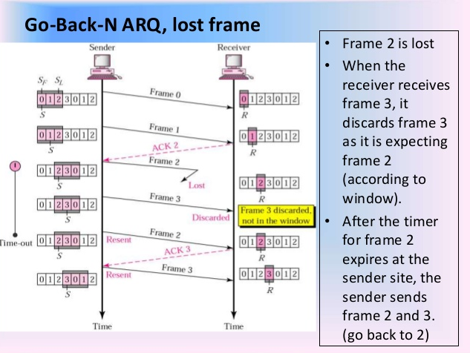
Go-Back-N ARQ

Slide 61
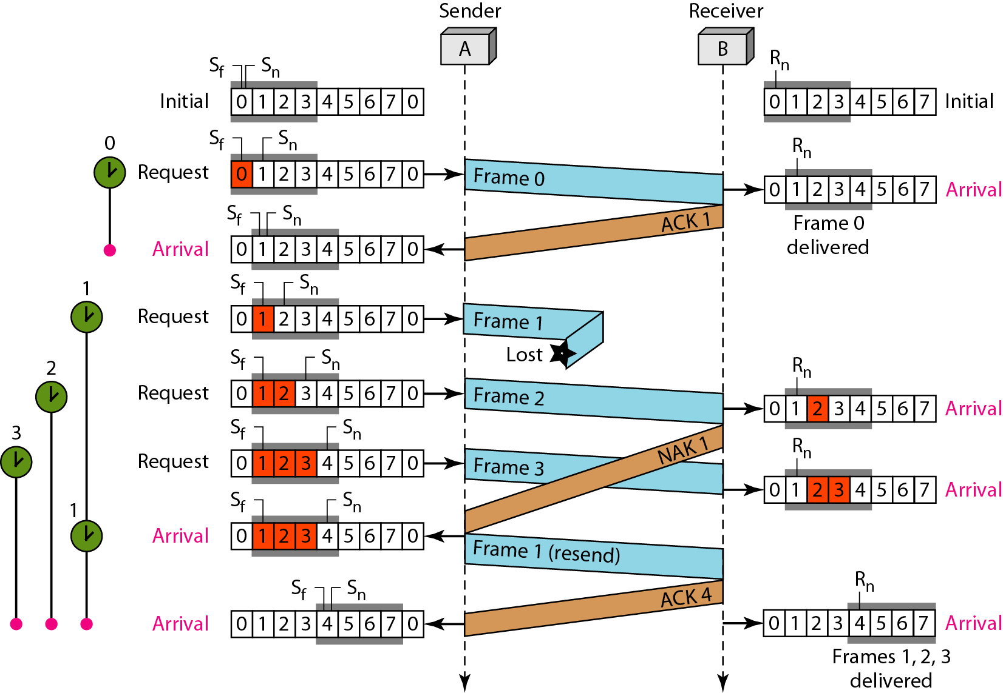

Slide 62
Selective Repeat ARQ
For noisy links, there is another mechanism that does not resend N frames(like Go-Back-N ARQ) when just one frame is damaged;
only the damaged frame is resent.
This mechanism is called Selective Repeat ARQ.
It is more efficient for noisy links, but the processing at the receiver is more complex.
In Selective Repeat ARQ, the size of the sender and receiver window must be at most one-half of 2^{m}

Slide 63
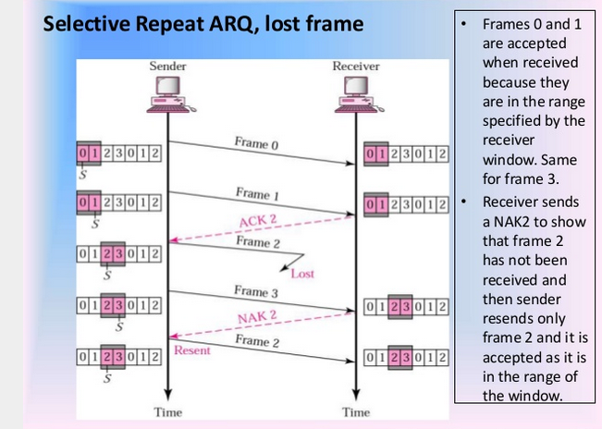
Selective Repeat ARQ

Slide 64
Sliding Window
Serves three different roles
Reliable
Preserve the order
Each frame has a sequence number
The receiver makes sure that it does not pass a frame up to the next higher-level protocol until it has already passed up all frames with a smaller sequence number
Frame control
Receiver is able to throttle the sender
Keeps the sender from overrunning the receiver
From transmitting more data than the receiver is able to process

Slide 65
Stop and wait
Sender window size (W_{s}) = 1
Receiver window size (W_{r}) = 1
Sequence Number ≥ 1 + 1
Uses independent acknowledgement
Discards out of order packets
Packet Loss ? Retransmit packet after time out
Acknowledgement loss ? Resends packet after time out
Efficiency = 1/(1+2a) where a = T_{p} / T_{t}

Slide 66
Go Back N
Sender window size W_{s} = N
Receiver window size W_{r} = 1
Sequence number ≥ N + 1
Can use both cumulative or independent acknowledgement depends on acknowledge timer
Discards out of order packets
Packet Loss ? Track back N size from the last packet within the window limit to the lost packet and retransmit them
Acknowledgement loss ? If not received before timeout the entire window N size is resend
Efficiency = N/(1+2a) where a = T_{p} / T_{t}

Slide 67
Selective Repeat
Sender window size W_{s} = N
Receiver window size W_{r} = N
Sequence Number ≥ N + N
Can Accept out of order packets
Packet Loss ? Resend only the lost packet after timeout
Acknowledgement loss ? Resend if not receive before timeout
Efficiency = N/(1+2a) where a = T_{p} / T_{t}

Slide 68
Problem 1
Consider an ARQ algorithm running over a
40-km point-to-point fiber link.
(a) Compute the one-way propagation delay for this link, assuming that the speed of light is 2×10^8 m/s in the fiber.
(b) Suggest a suitable timeout value for the ARQ algorithm to use.

Slide 69
Solution
(a) Propagation delay = 40 × 10^3m/(2 × 10^8m/s) = 200 μs.
(b) The roundtrip time would be about 400μs.depending on the amount of variation in actual RTTs.

Slide 70
Problem 2
Suppose you are designing a sliding window protocol for a 1-Mbps point-to-point link to the moon, which has a one-way latency of 1.25 seconds. Assuming that each frame carries 1 KB of data. what is the minimum number of bits you need for the sequence number?

Slide 71
Solution
Bandwidth×(roundtrip)delay =1x10^6 × 2.5s = 312 KB, or 312 packets / frames.
The window size should be this large; the sequence number space must cover twice this range, or up to 624.
10 bits are needed.

Slide 72
Problem 3
Suppose you are designing a sliding window protocol for a 1-Mbps point-to-point link to the stationary satellite revolving around the Earth at an altitude of 3×10^4 km. Assuming that each frame carries 1 KB of data, what is the minimum number of bits you need for the sequence number in the following cases?
Assume the speed of light is 3×10^8 m/s.
(a) RWS = 1
(b) RWS = SWS

Slide 73
Solution
(Bandwidth) × (round trip delay) or 25 packets. SWS should be this large.
(a) If RWS=1,the necessary sequence number space is 26. Therefore, 5 bits are needed.
(b) If RWS=SWS, the sequence number
Space must cover twice the SWS, or up to 50. Therefore, 6 bits are needed.

Slide 74
Problem 4
Draw a timeline diagram for the sliding window algorithm with SWS = RWS = 3 frames, for the following two situations. Use a timeout interval of about 2 x RTT
Frame 4 is lost
Frame 4 to 6 is lost.

Slide 75
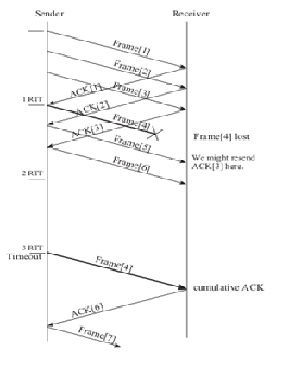
Solution

Slide 76
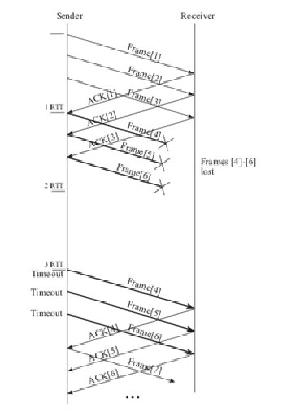
Solution

Slide 77


Stop-and-Wait
t_{f} – Transmit delay of the data frame
t_{d} – Propagation delay of 1 bit in a frame
t_{p} – Processing delay of the data frame
t_{q} – Queuing delay of the data frame
t_{a} – Transmit delay of ACK frame
RTT= 2x t_{d}
Sender
Receiver
t_{f}
t_{d}
Total Transmission Time
t_{p}+t_{q}
t_{d}
t_{a}

Slide 78





Stop-and-Wait
In practice, in most cases:
t_{p} and t_{q} is ignored.
t_{a} is very small compared to t_{f}
Hence,
Ie.,
where a= t_{d} /t_{f}
a- Transmission Coefficient
ie,
ie,
Also
k – Actual information bits in a frame.
Throughput = U x Bandwidth
Sender
Receiver
t_{f}
t_{d}
Total Transmission Time
t_{p}+t_{q}
t_{d}
t_{a}

Slide 79


If Send Window Size of N
t_{f} – Transmit delay of the data frame
t_{d} – Propagation delay of 1 bit in a frame
t_{p} – Processing delay of the data frame
t_{q} – Queuing delay of the data frame
t_{a} – Transmit delay of ACK frame
N – No of frames transmitted continuously before acknowledgement(Window Size)
k – Size of the frame.
If node is able to transmit data continuously then Utilization = 1
If transmission has to stop for acknowledgment after t_{f} +2t_{d} time then:
Also,
Sender
Receiver
t_{f}
t_{d}
Total Transmission Time for 1 packet
t_{p}+t_{q}
t_{d}
t_{a}
N = 3

Slide 80
Problem
Assume that, in a Stop-and-Wait ARQ system, the bandwidth of the line is 1 Mbps, and 1 bit takes 20 ms to make a round trip. If the system data frames are 1000 bits in length, what is the utilization percentage of the link?
DBP= RTT*BW=20*10^-3*1x10^6
what is the utilization percentage =1/1+2a

Slide 81
Solution
Link Capacity=20,000 bits
Utilization % = 5%

Slide 82
Problem
Assume that, in a Go-back-N ARQ system, the bandwidth of the line is 1 Mbps, and 1 bit takes 20 ms to make a round trip. Assume 15-frame sequence. If the system data frames are 1000 bits in length, what is the utilization percentage of the link?

Slide 83
Solution
Link Capacity=20,000 bits
Utilization % = 75%

Slide 84
Problem
A point-to-point satellite transmission link connecting two computers uses stop-and-wait ARQ strategy and has the following characteristics:
Data transmission rate = 64 kbps
Frame size = 2048 bytes
Information bytes per frame = 2043 bytes
Propagation delay = 180 ms
Acknowledgement Size = 10 bytes
Processing delay = 50 ms
Determine the throughput and efficiency.

Slide 85
Frame transmission time tf = (2048 x 8) / (64000) = 0.256 sec.
Acknowledgement transmission time ta = (10 x 8) / (64000) = 1.25 msec.
Total time to transmit frame and receive an acknowledgement is:
tf + ta + tp + 2td = 0.256 + 0.00125 + 0.05 + 0.36 = 0.66725 sec.
Throughput k = (2043 x 8) / (0.66725) = 24.494 Kbps.
Note that the resulting throughput is considerably less than the transmission rate of 64 kbps.
The link efficiency (Utilization)can now be calculated, neglecting ta and tp, as follows: a = (td) / (tf) = (0.18) / (0.256) = 0.7
U = (1) / (1 + 2a) = (1) / (1 + 1.4) = 41.67 %.

Slide 86
Solution
Efficiency = 41.67%
Throughput = 24.5kbps

Slide 87
Problem
A frame-oriented data communications system operates at a transmission rate of 512 kbps with a frame length of 512 bytes over a long-distance link which produces a propagation delay of 20 ms. It operates using a go-back-3 ARQ system (with a window size of 3) and 506 information bytes in each frame, determine:
(a) the efficiency,
(b) the throughput

Slide 88
Frame length, n = 512 bytes. Information bits, k = 506 bytes. Delay time, td = 20 ms. Frame transmission time, tf = 8 ms.
Window size, N = 3.
U = (N) / (1 + 2a) where a = td / tf = 20 / 8 = 2.5 therefore: Efficiency (U) = (3) / (6) = 0.5 => 50%.
Throughput = (No. of Information bits transmission) / (Total time taken).
= (Nk) / (tf + 2td)
= (3 x 506 x 8) / (8 + 40) x 10^-3 = 253 Kbps.

Slide 89
Solution
Efficiency = 0.5
Throughput = 253 kbps

Slide 90
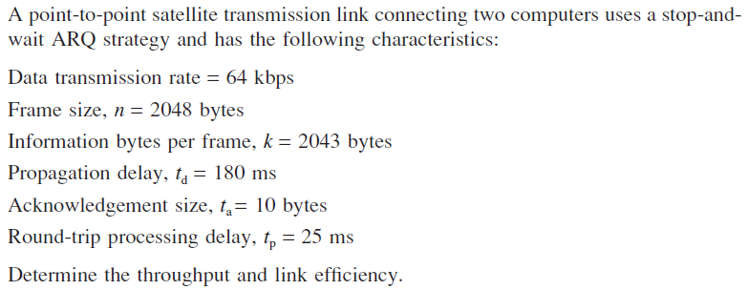
Problem

Slide 91
Solution
Efficiency = 41.67%
Throughput = 24.5kbps

Slide 92
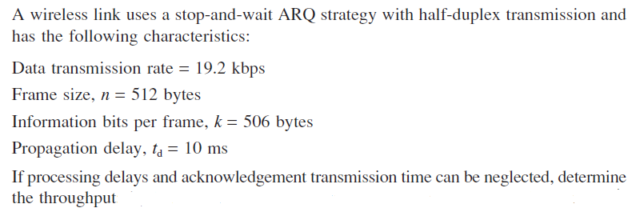
Problem

Slide 93
Solution
Throughput = 17373.39 bps

Slide 94
Problem
A frame-oriented data communications system operates at a transmission rate of 512 kbps with a frame length of 512 bytes over a long-distance link which produces a propagation delay of 20 ms. It operates using a go-back-3 ARQ system (with a window size of 3) and 506 information bytes in each frame, determine:
(a) the efficiency,
(b) the throughput

Slide 95
Solution
Efficiency = 0.5
Throughput = 253 kbps

